Slide 1

Study sync- UID project

Ms. Arya R
Team Members: Faculty:
Ms. Arya. R
Ch Shashank- BL.SC.U4AIE24011
C. Dhanush- BL.SC.U4AIE24010
D. Yuva Akhil- BL.SC.U4AIE24013
P. Varun Sathwik-BL.SC.U4AIE24035

Slide 2

Features
Login Page
Home Page
Pomodoro Timer
Flash Cards
Quizzes
Calendar with Remainders

Slide 3
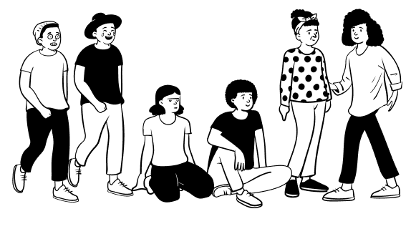
Login Page
Concepts Used:
Firebase for Login Authentication
HTML Forms
CSS transitions

Slide 4
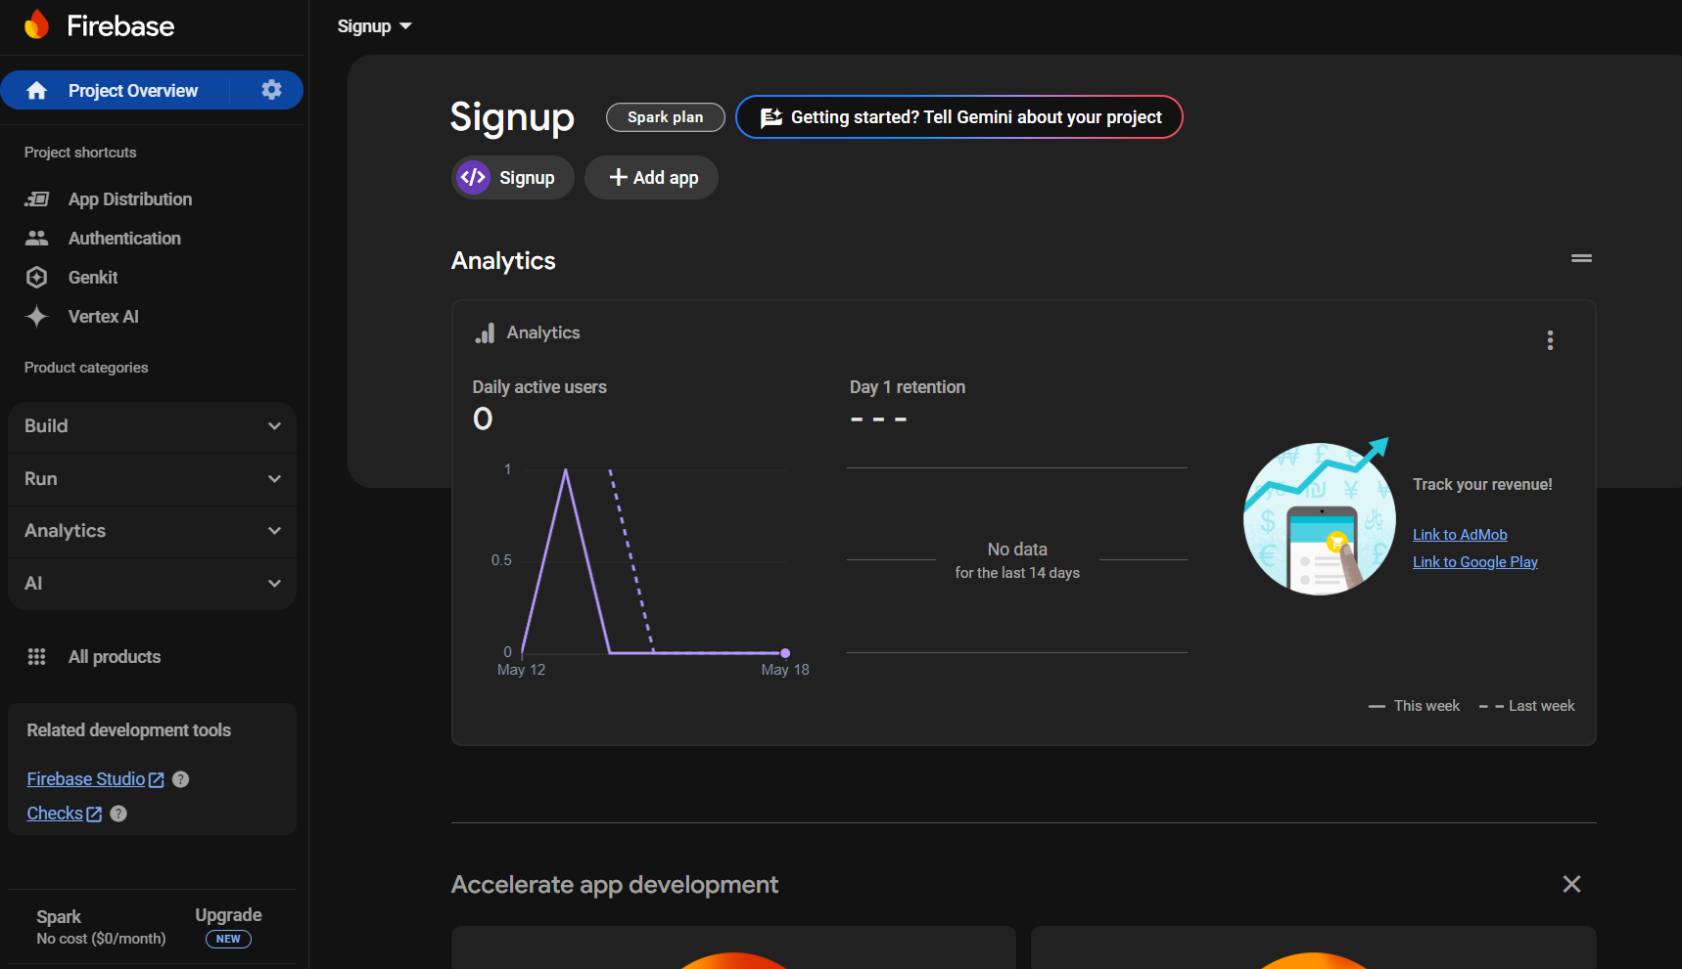

Slide 5
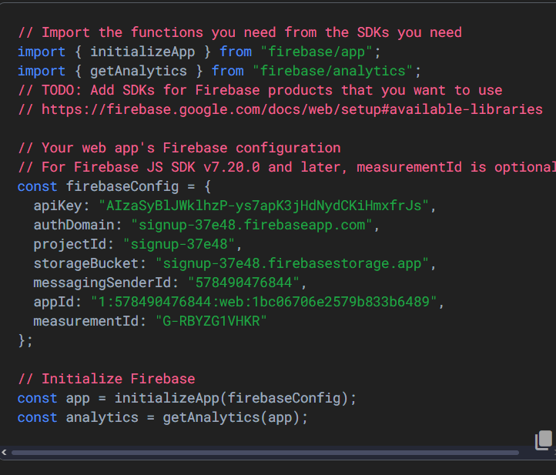

Slide 6
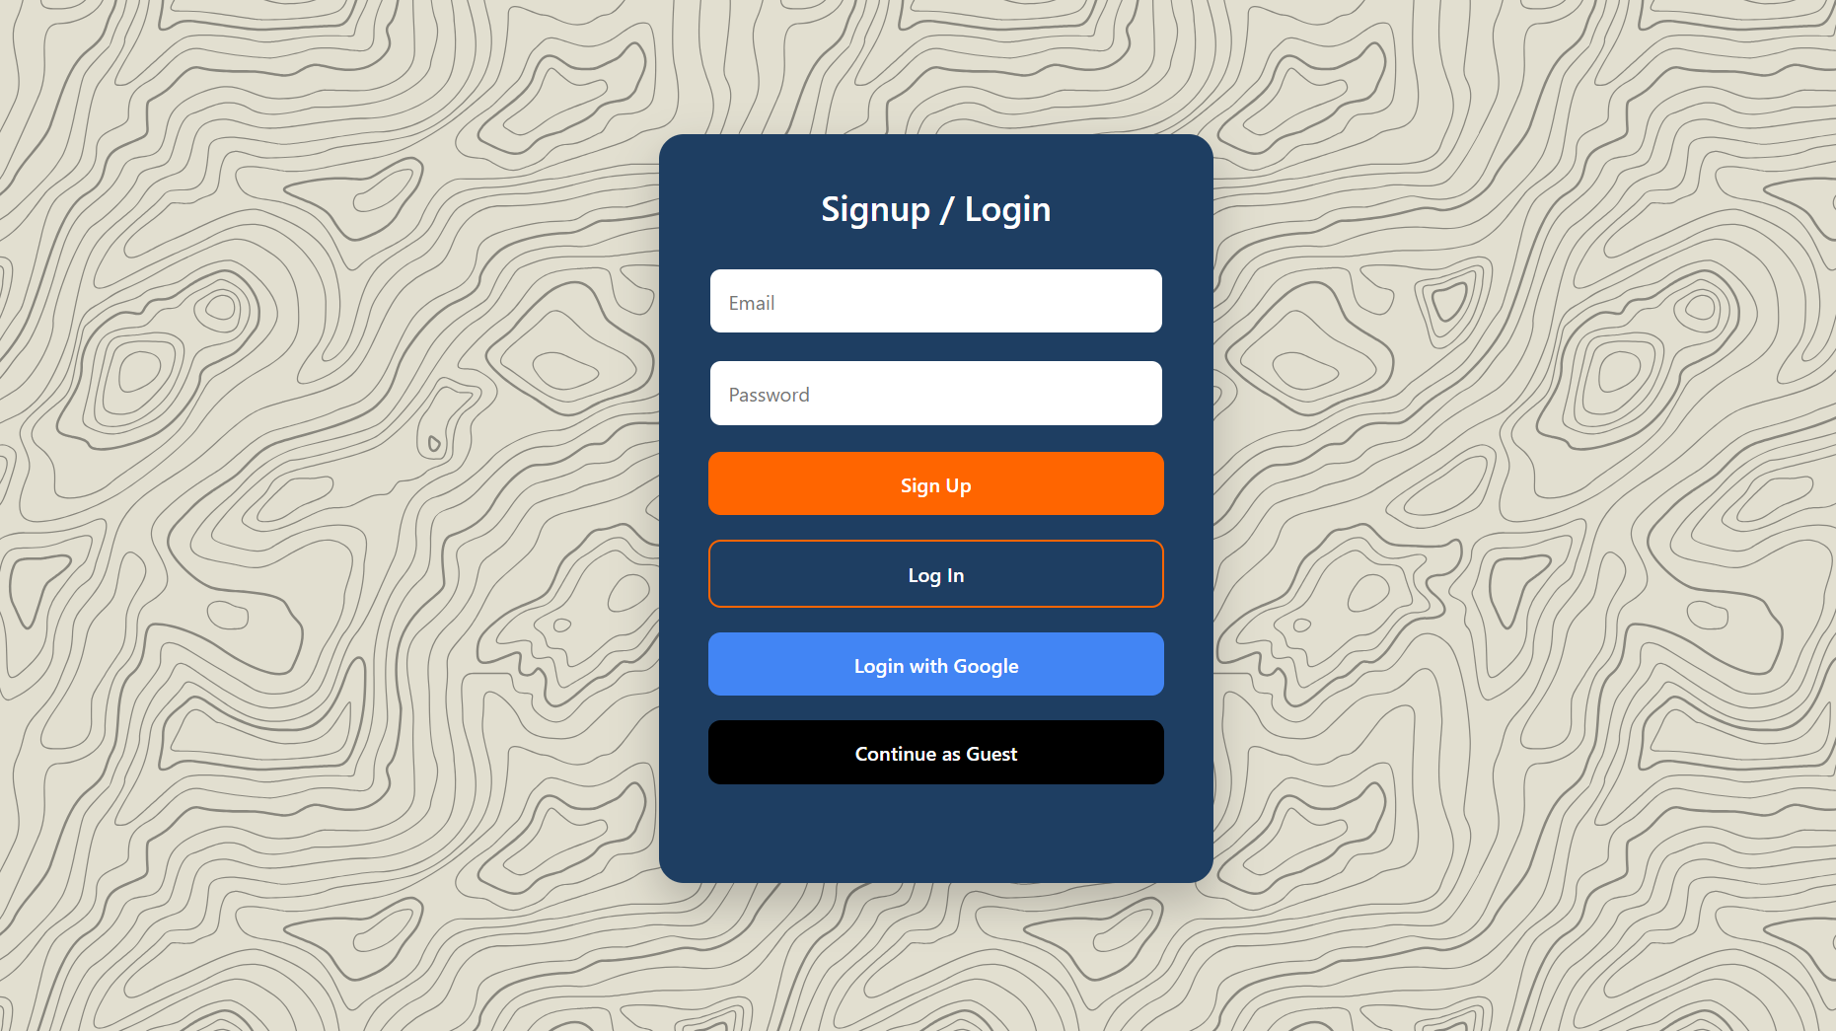

Slide 7
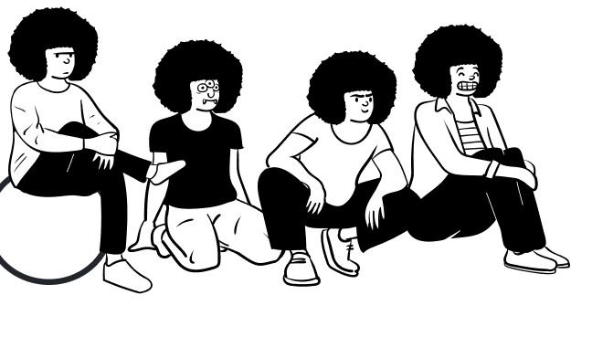
Home Page
Concepts Used
Headers and Footers
Divs Many Many Divs..
Side bars buttons
Positioning Absolute, Relative etc
Flexboxes

Slide 8
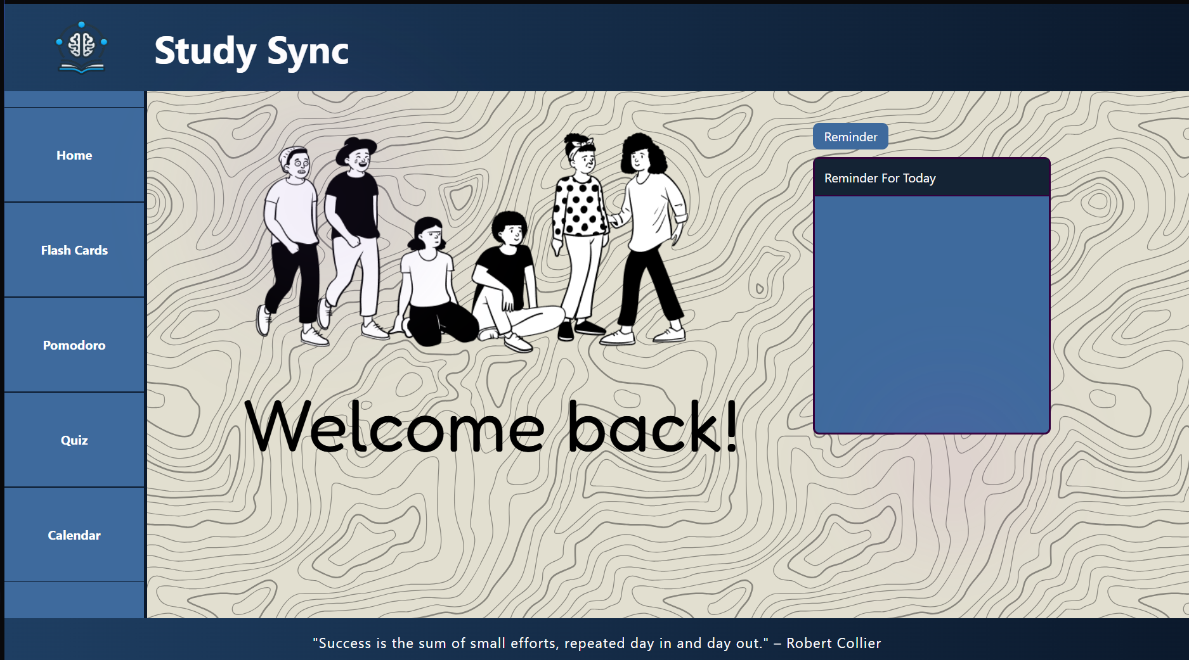

Slide 9
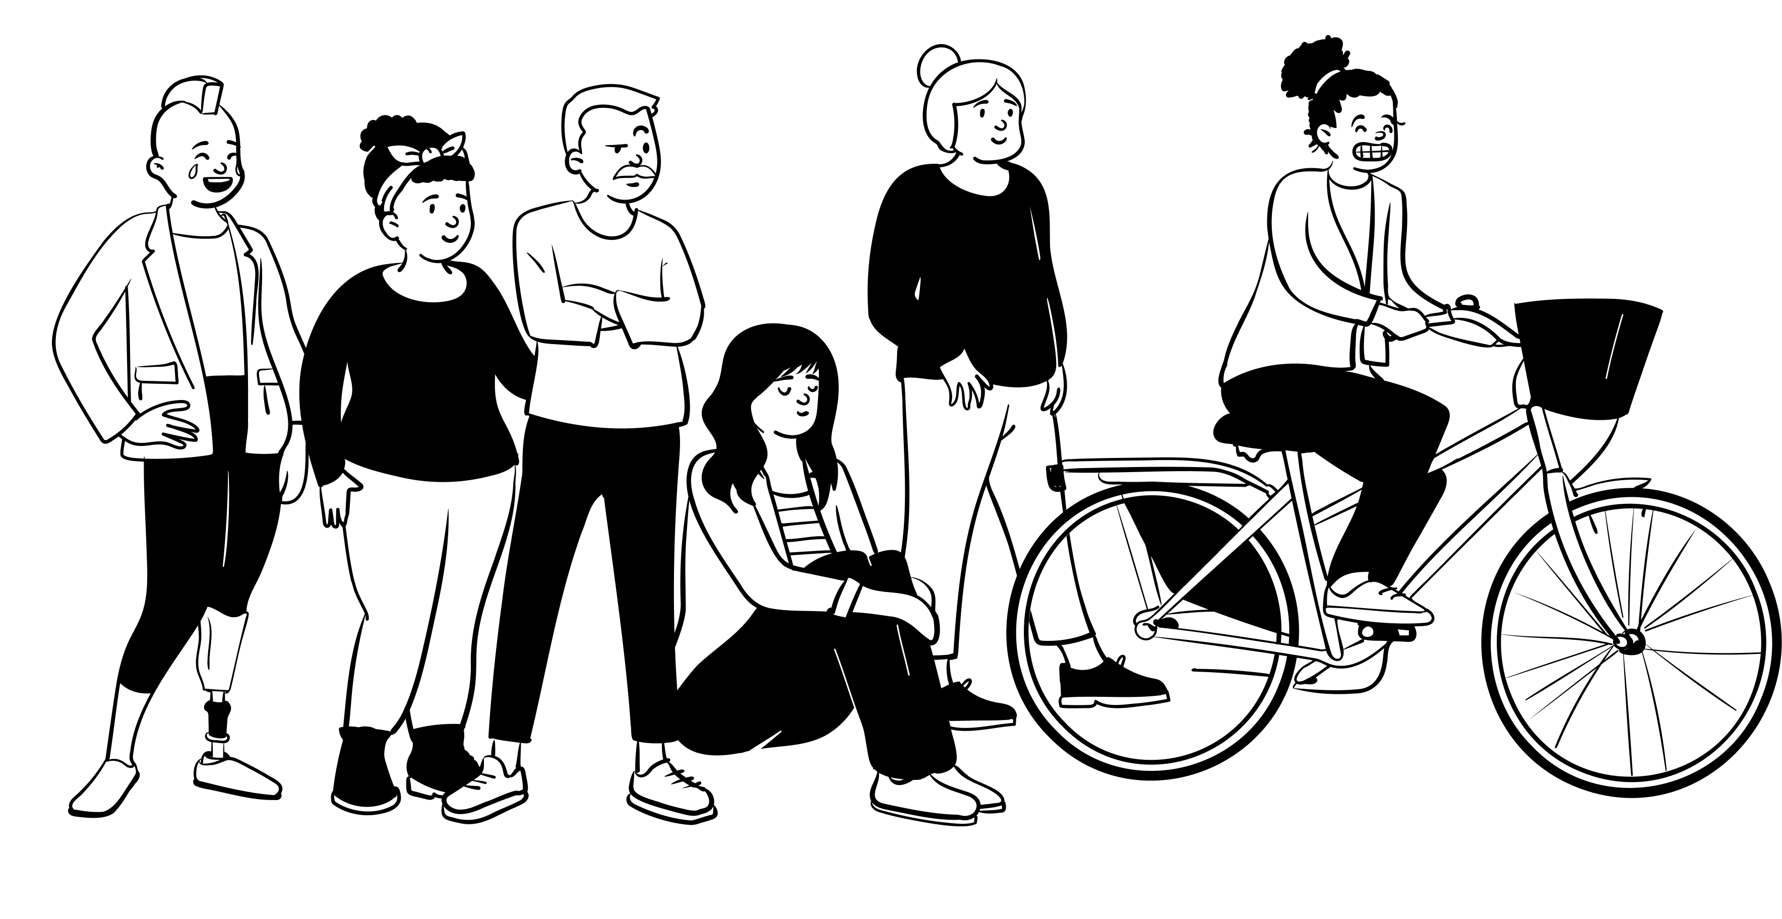
Flash Cards
Concepts Used
CSS Transform
JS for storing Flash Cards

Slide 10
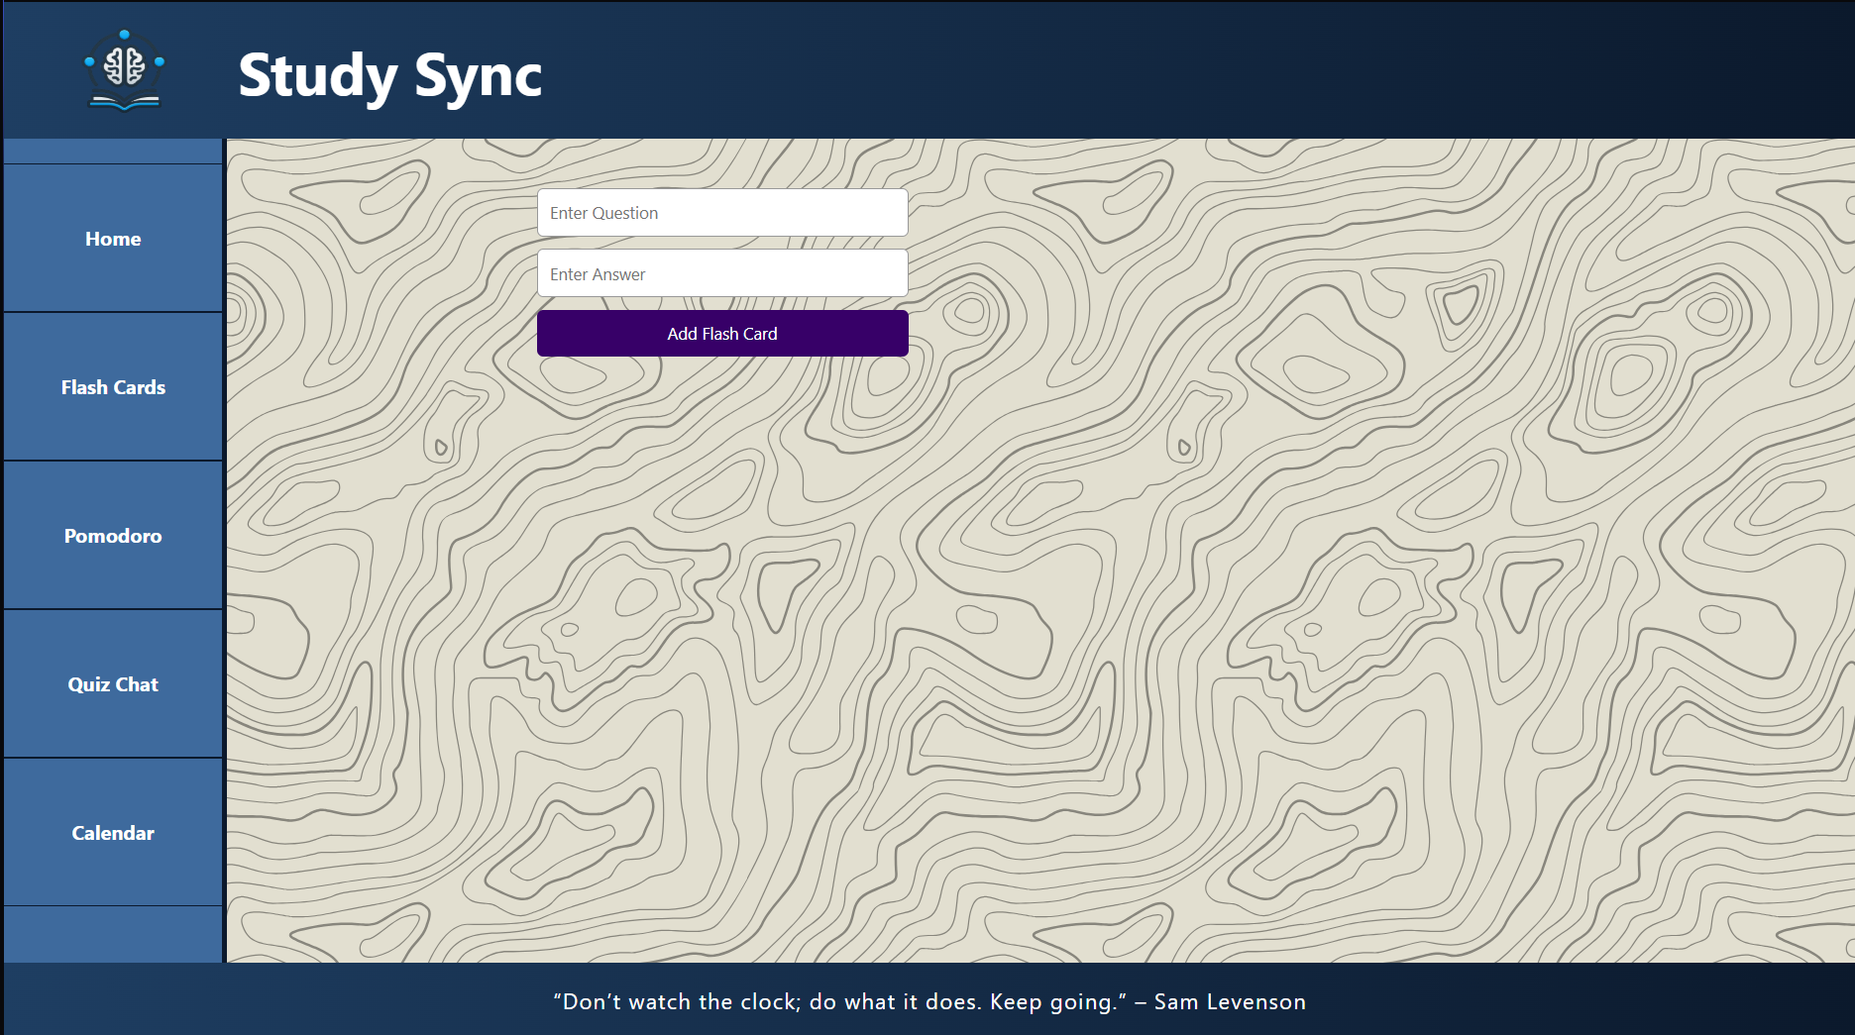

Slide 11
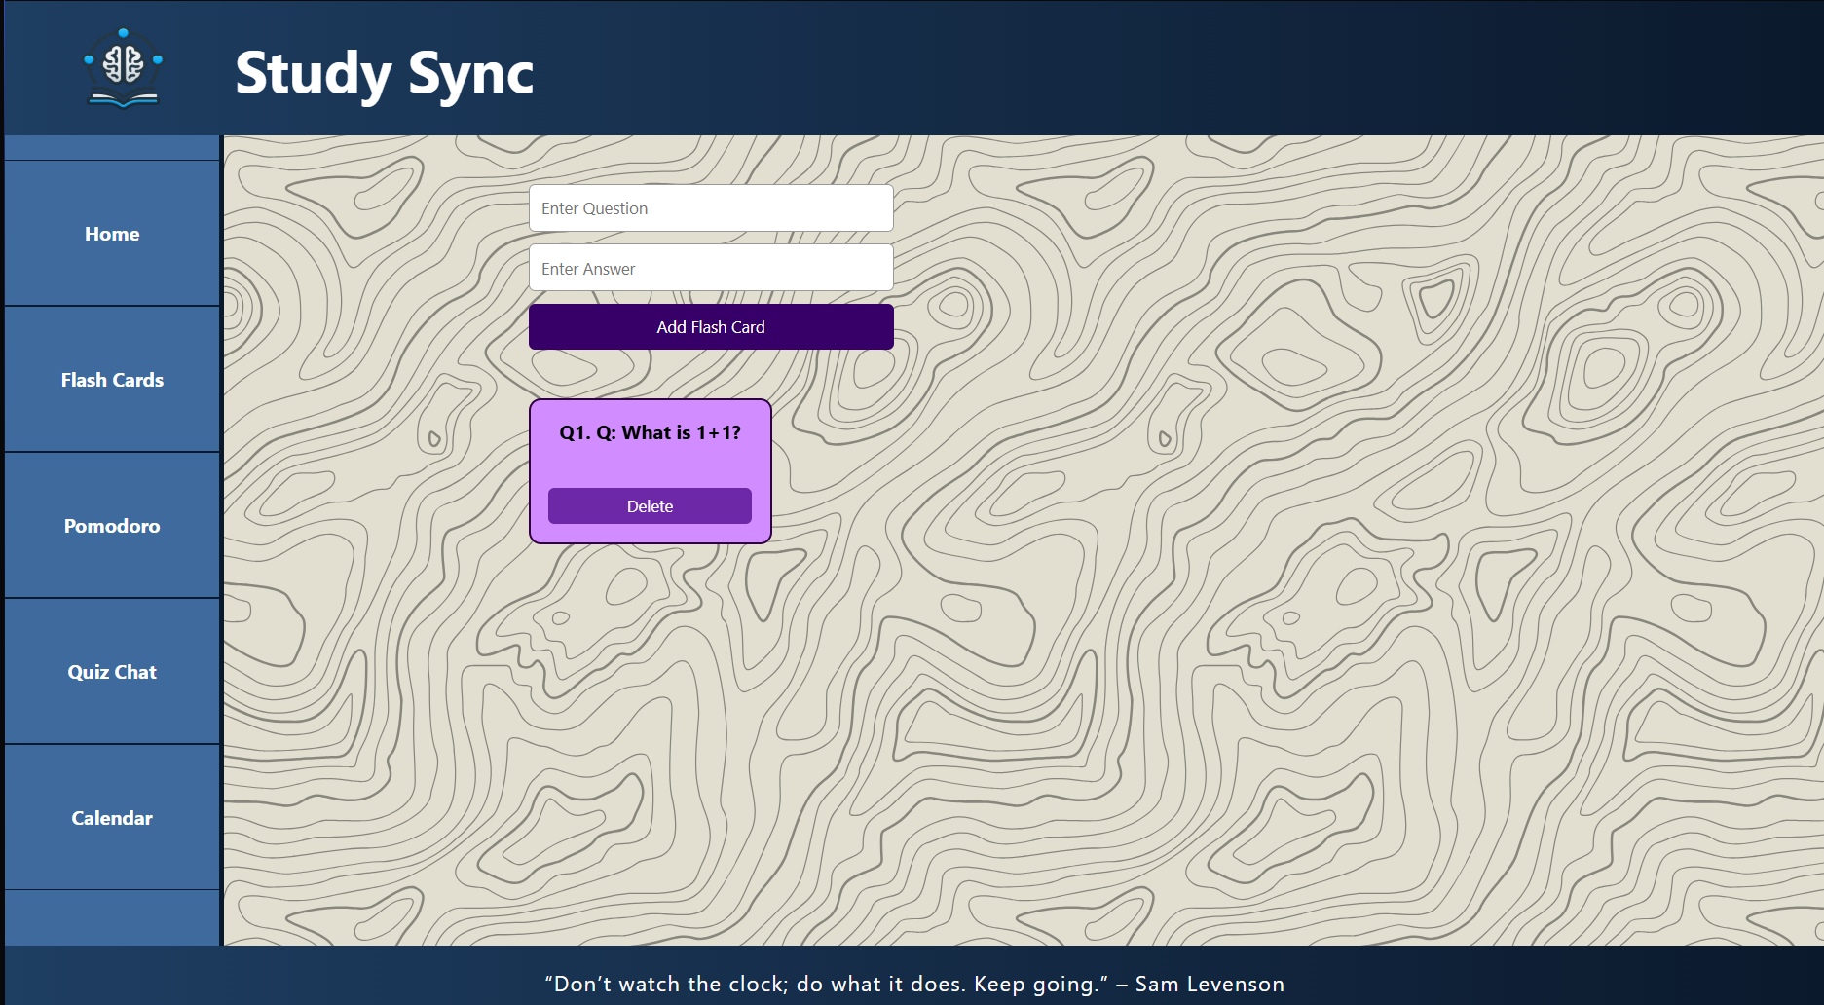

Slide 12
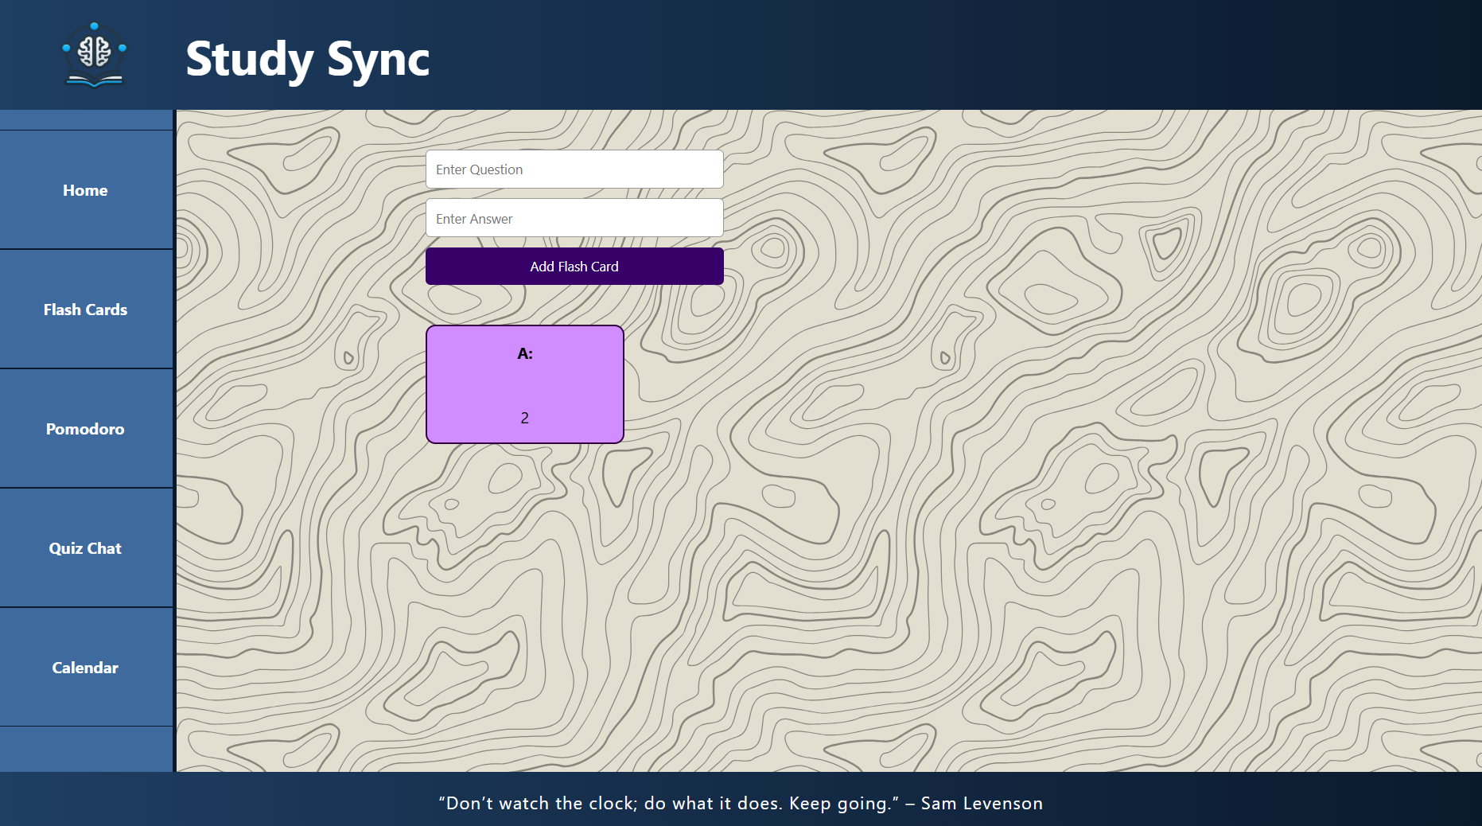

Slide 13
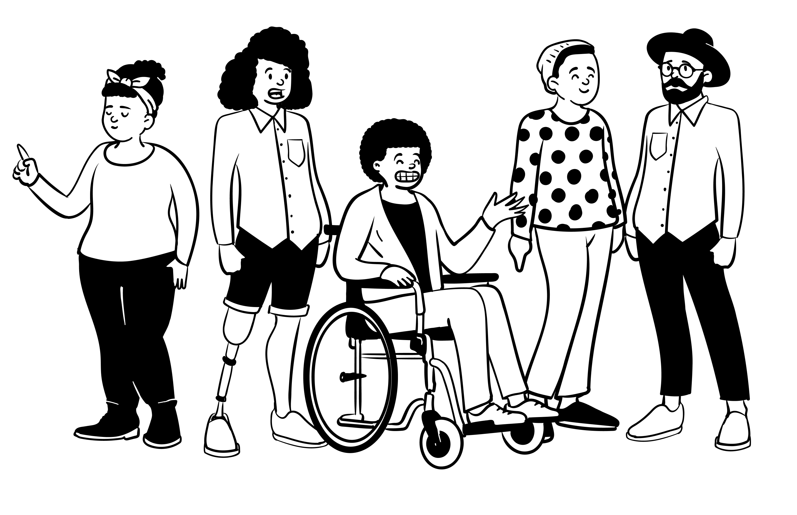
Pomodoro Timer
Simple Timer made with the help of JS

Slide 14
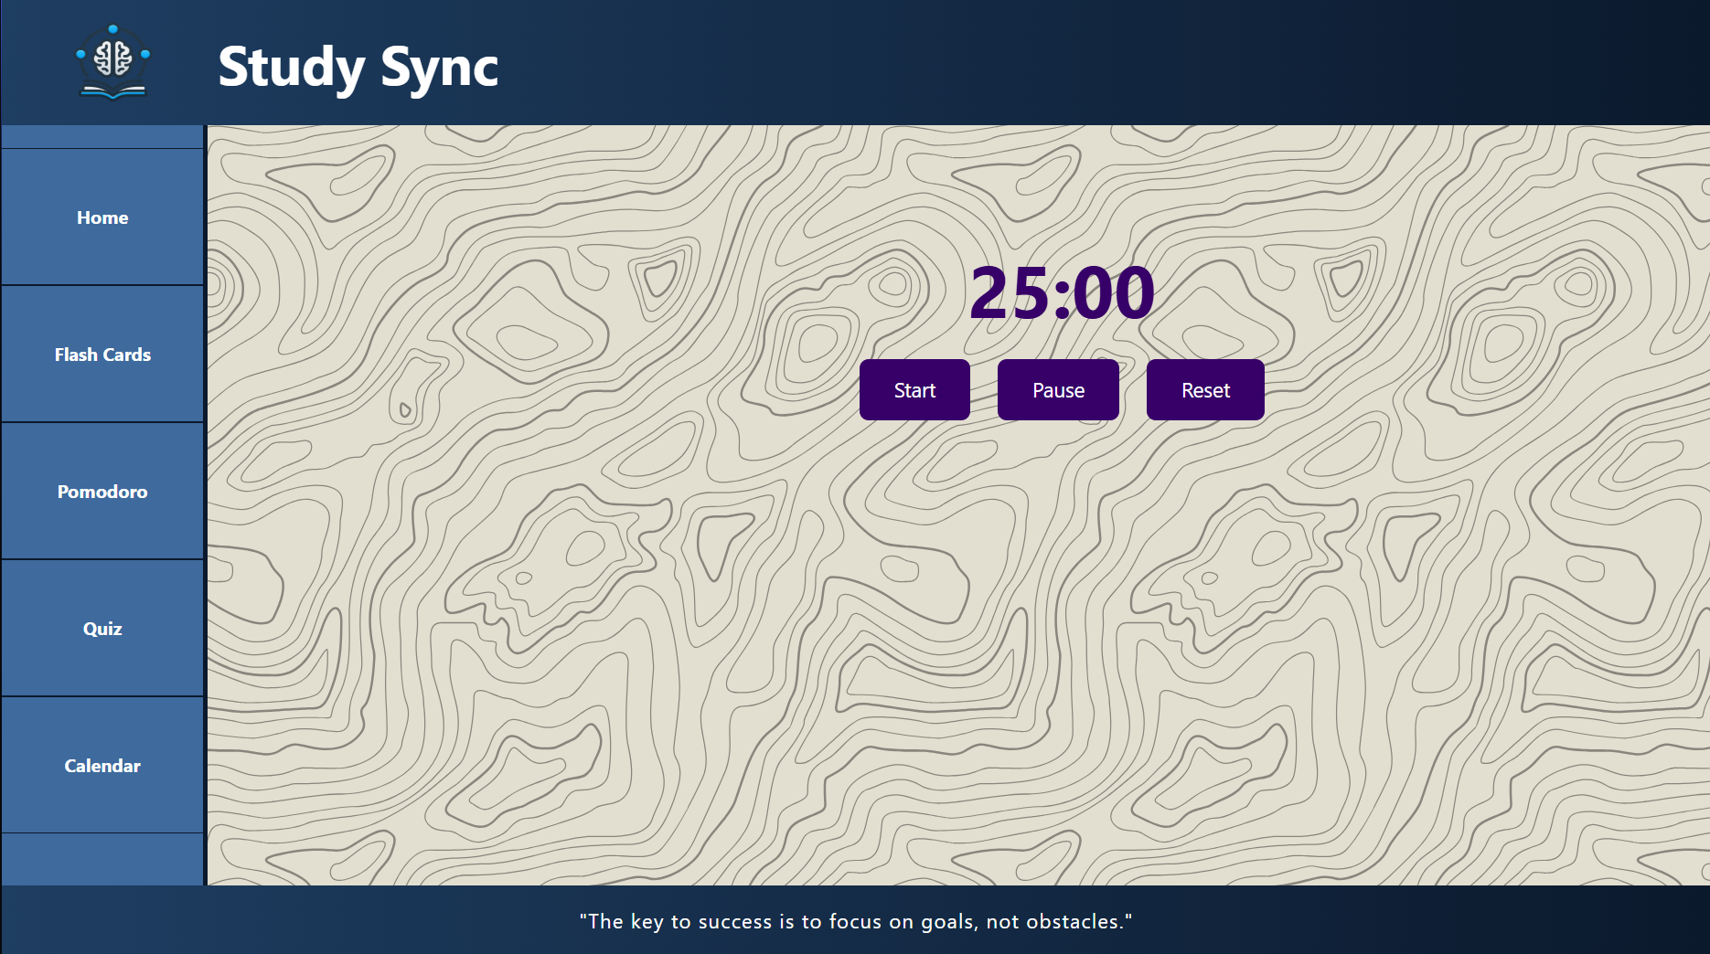

Slide 15
Quiz
Made 55 predefined questions for 6 subjects
User can select the number of questions they want

Slide 16
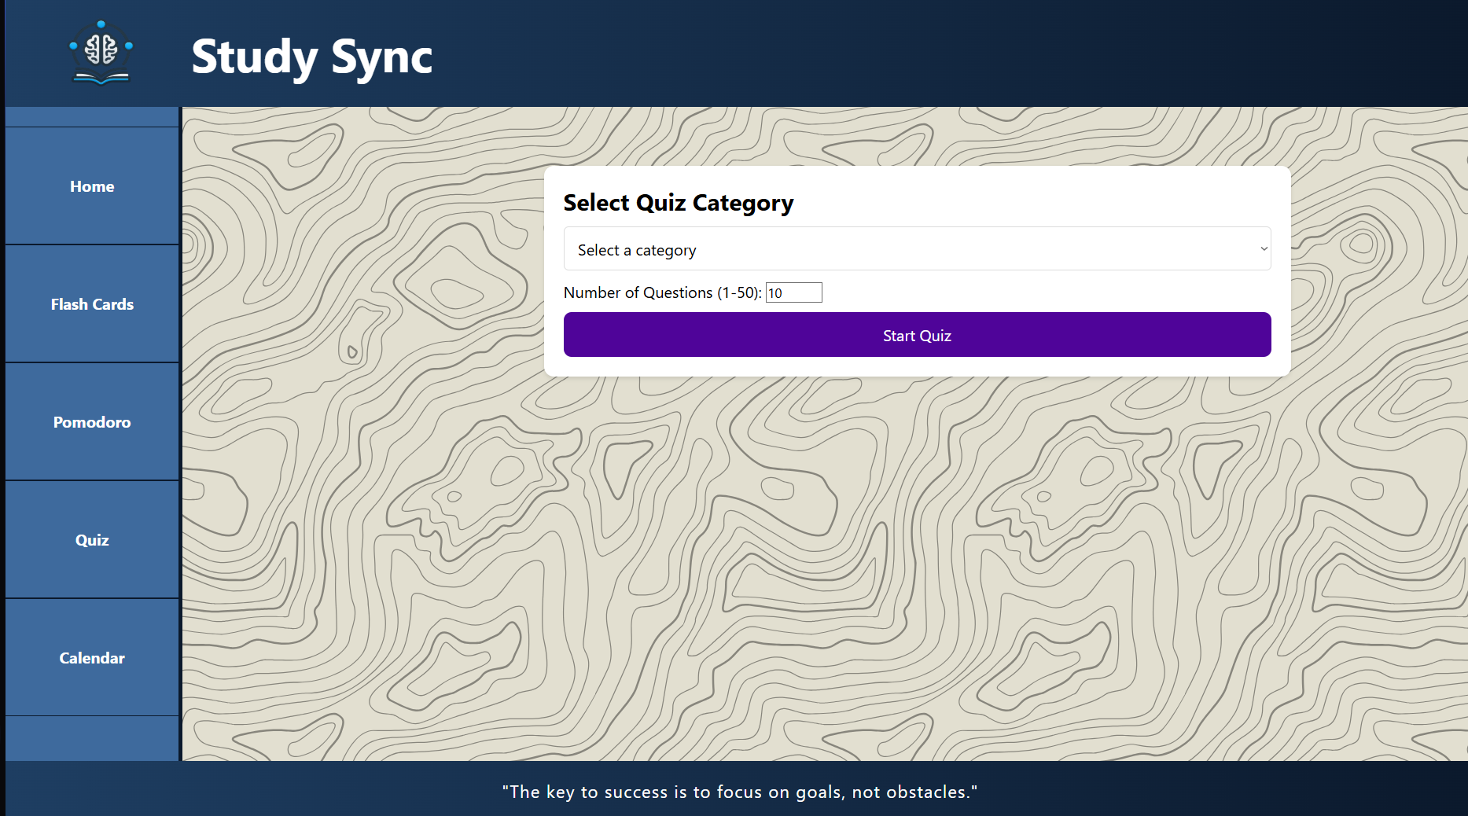

Slide 17
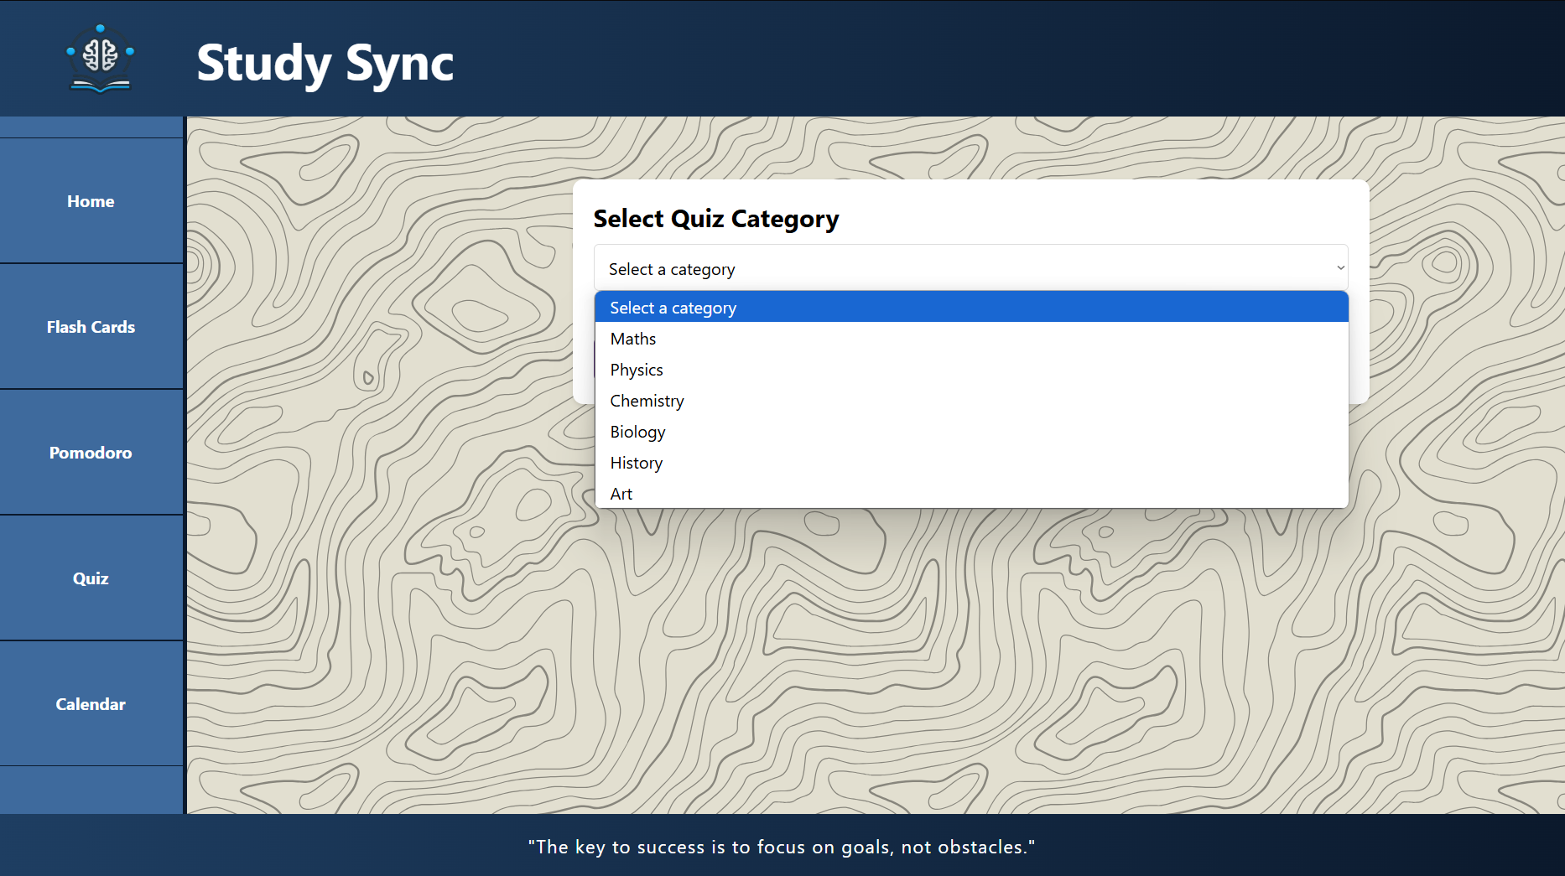

Slide 18
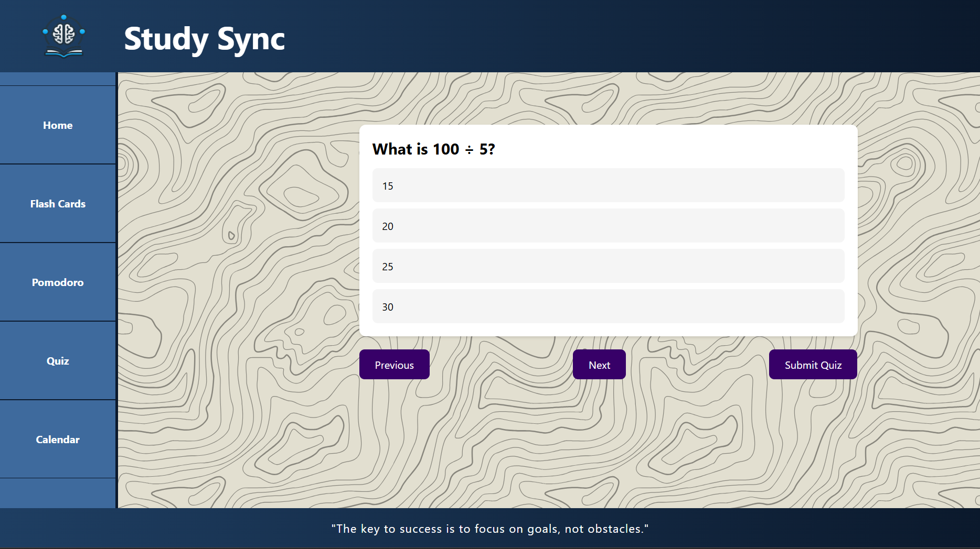

Slide 19
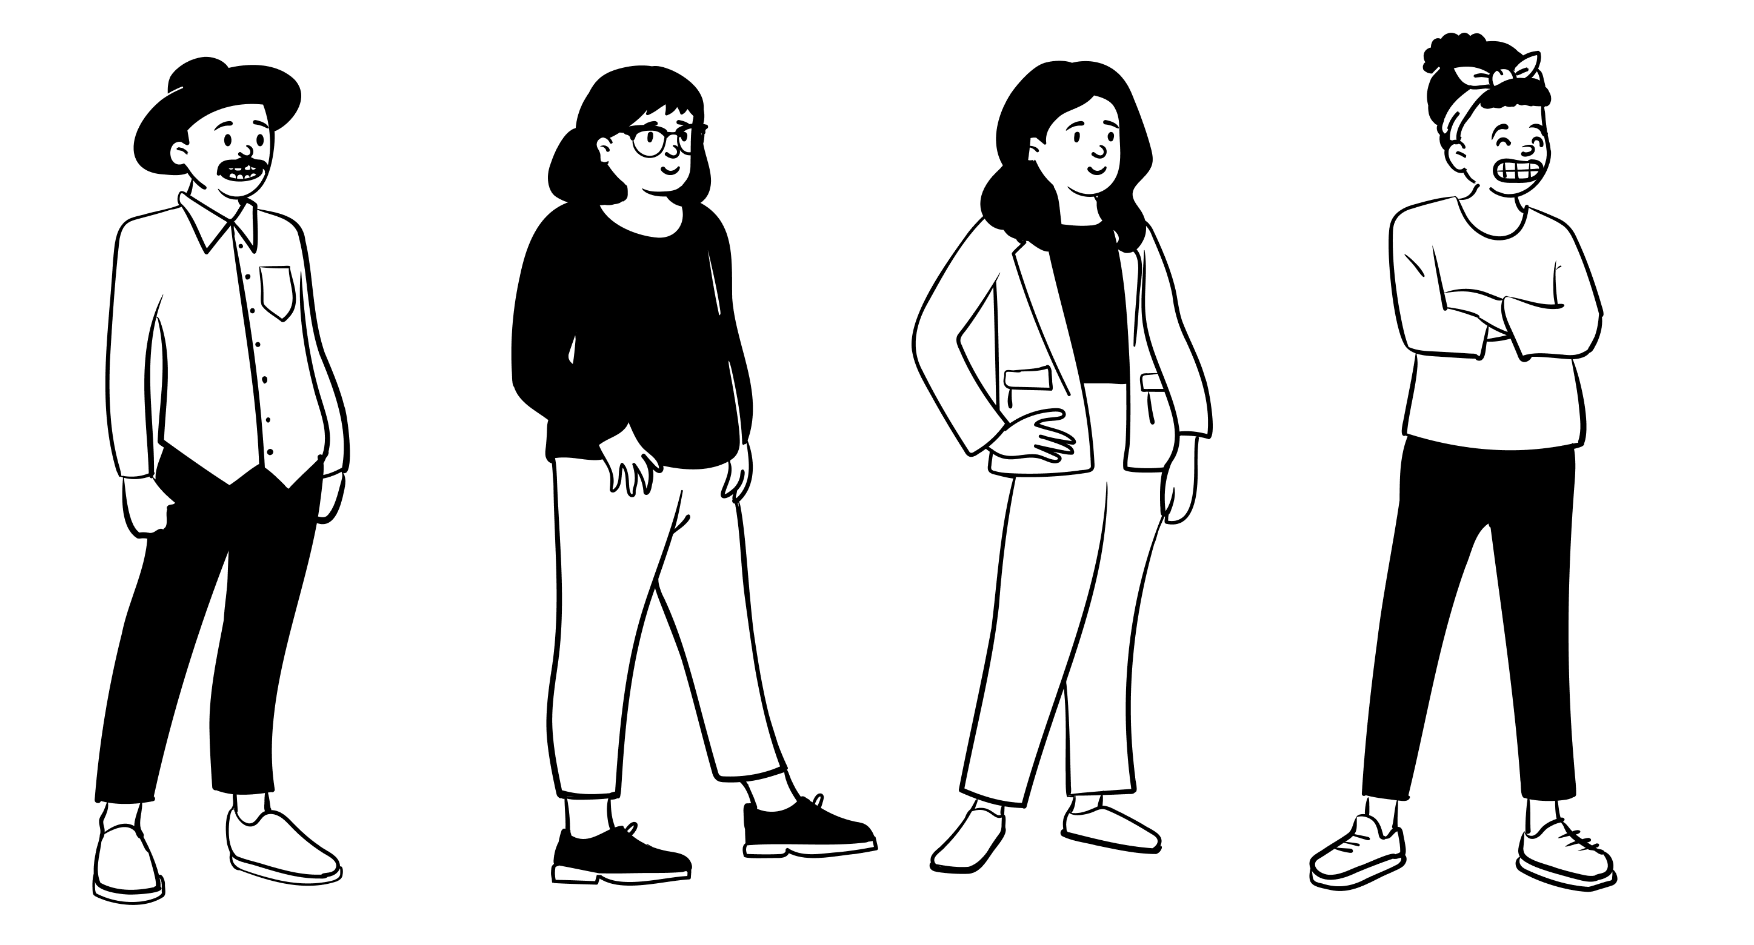
Calendar
Made Calendar with JS
Added the feature of remainders which also appear on home screen

Slide 20
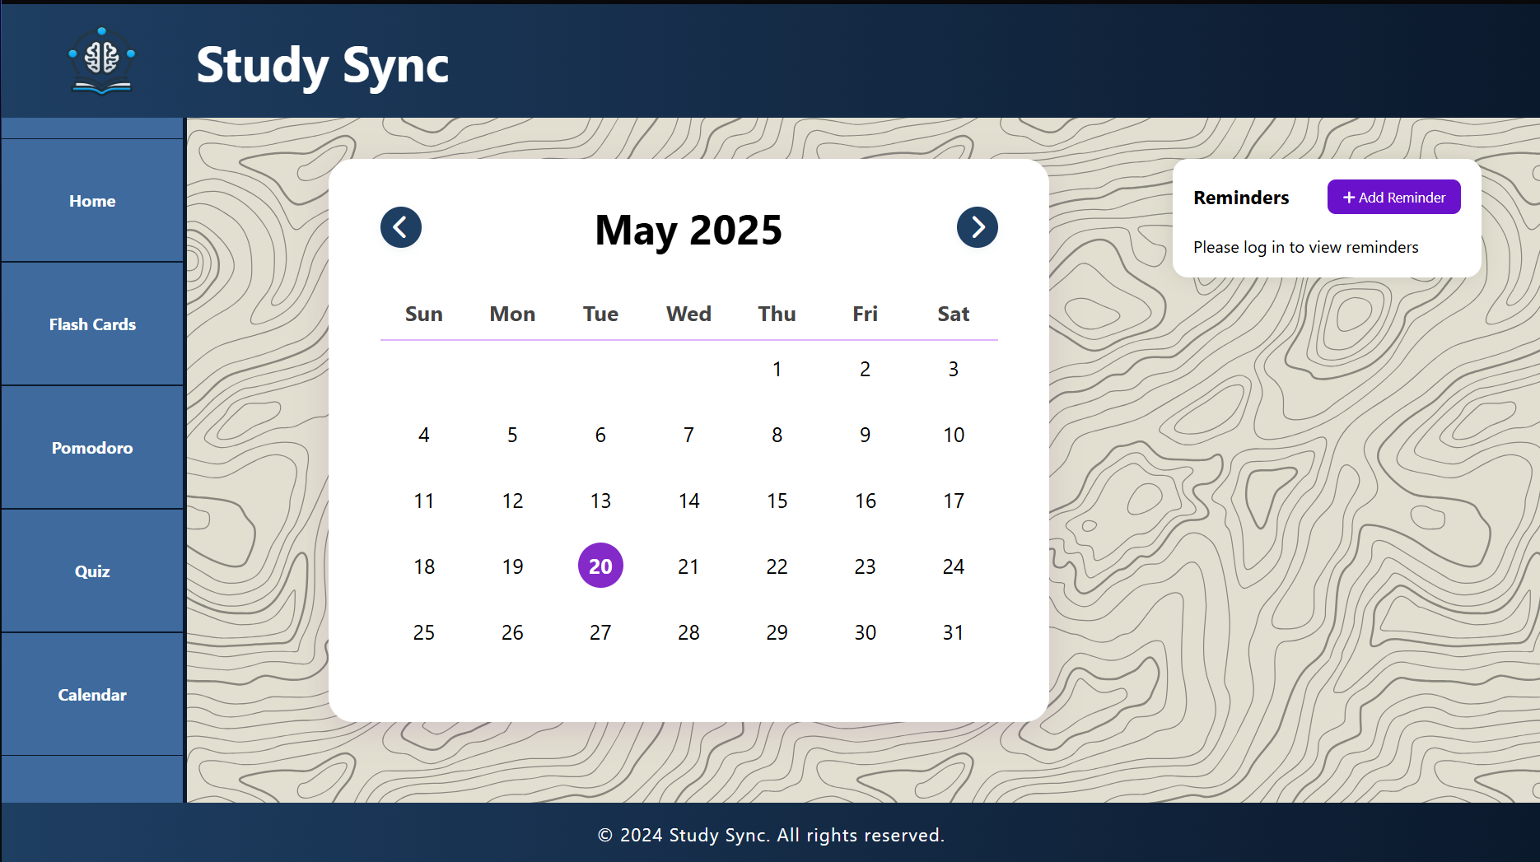

Slide 21

This Photo by Unknown Author is licensed under CC BY-NC-ND

